Slide 1
Final Project
Ivashenyuk Yuriy

Slide 2
Where do I get the data?
Facebook - Getting the location
Randomuser – The information about users
Cagematch – Name of Tournaments
Mithrilandmages – Name of Banks
Fantasyfootball – Name of Teams and Clubs

Slide 3
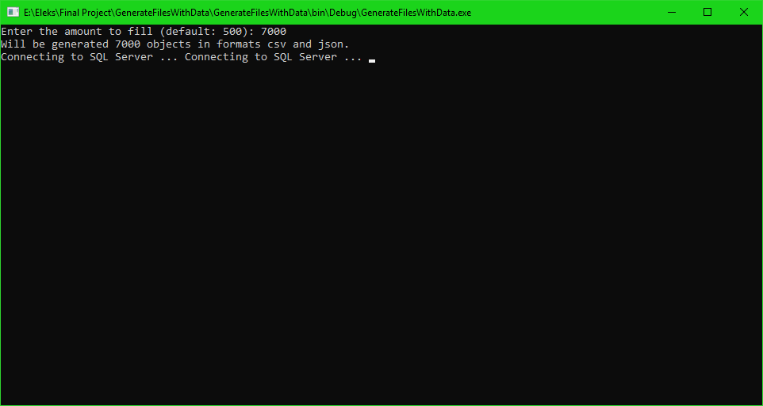
How do I generate csv and json?

Slide 4
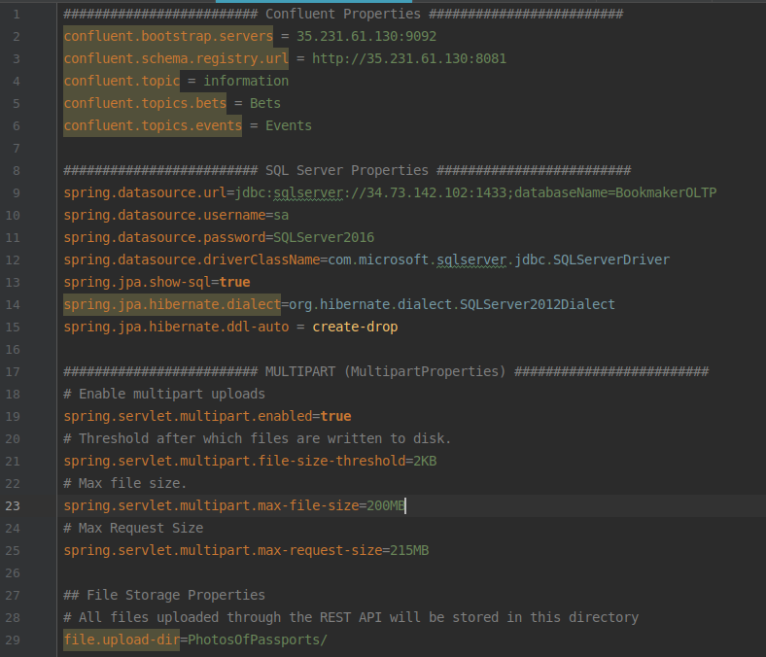
API Configurations

Slide 5
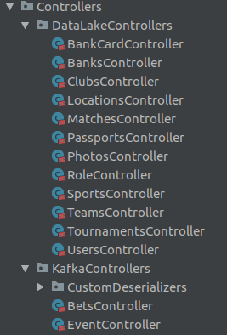
API Controllers

Slide 6
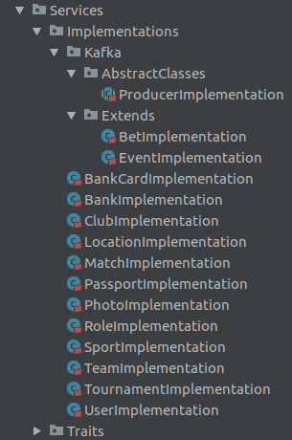
API Services

Slide 7
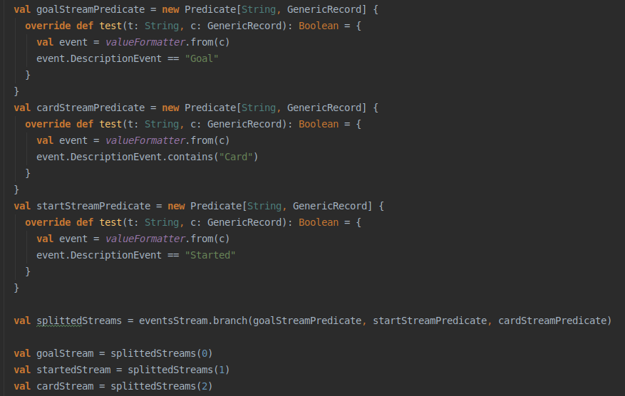
Kafka streaming – split to three streams

Slide 8
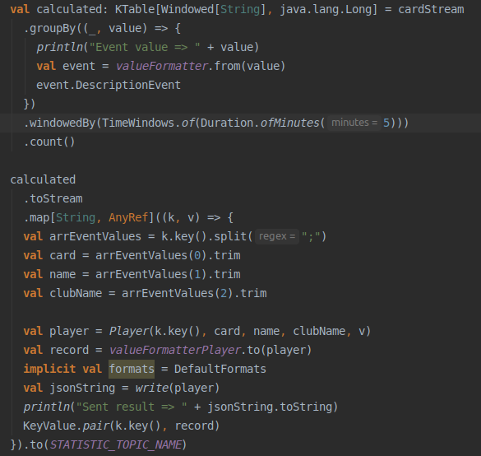
Kafka streaming – calculate cards by 1 minute ago (Tumbling Window)

Slide 9
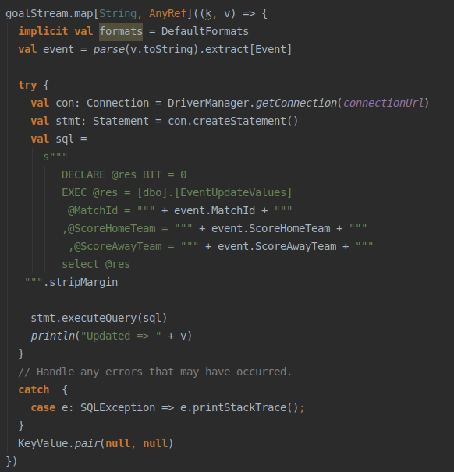
Kafka streaming – change score matches

Slide 10
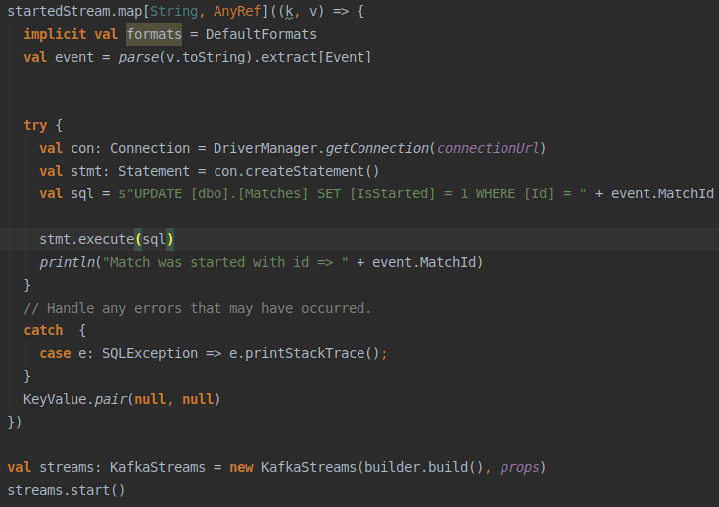
Kafka streaming – update status match

Slide 11
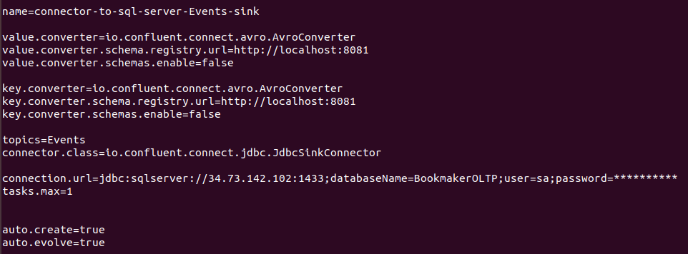
Confluent Connectors

Slide 12
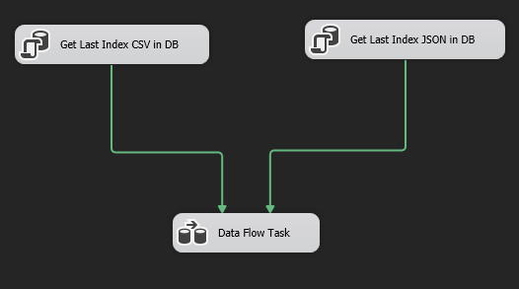
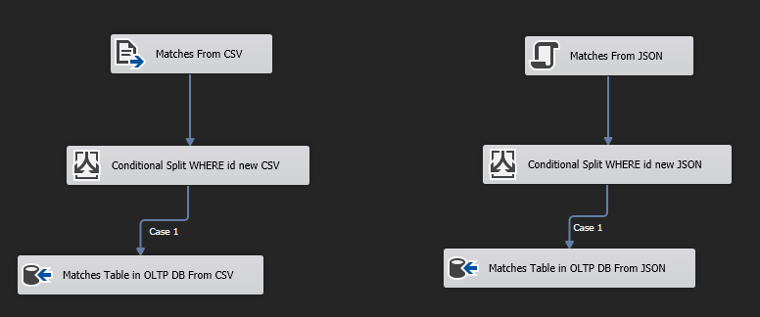
ETL – from CSV and JSON files

Slide 13
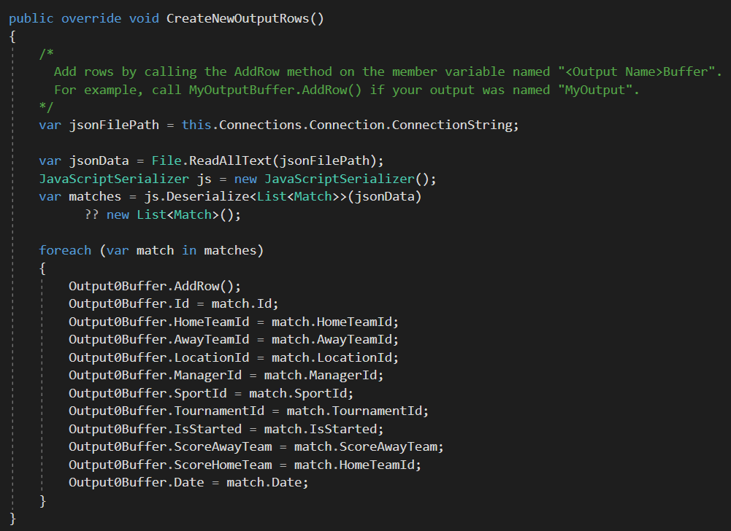
ETL – parse JSON file

Slide 14
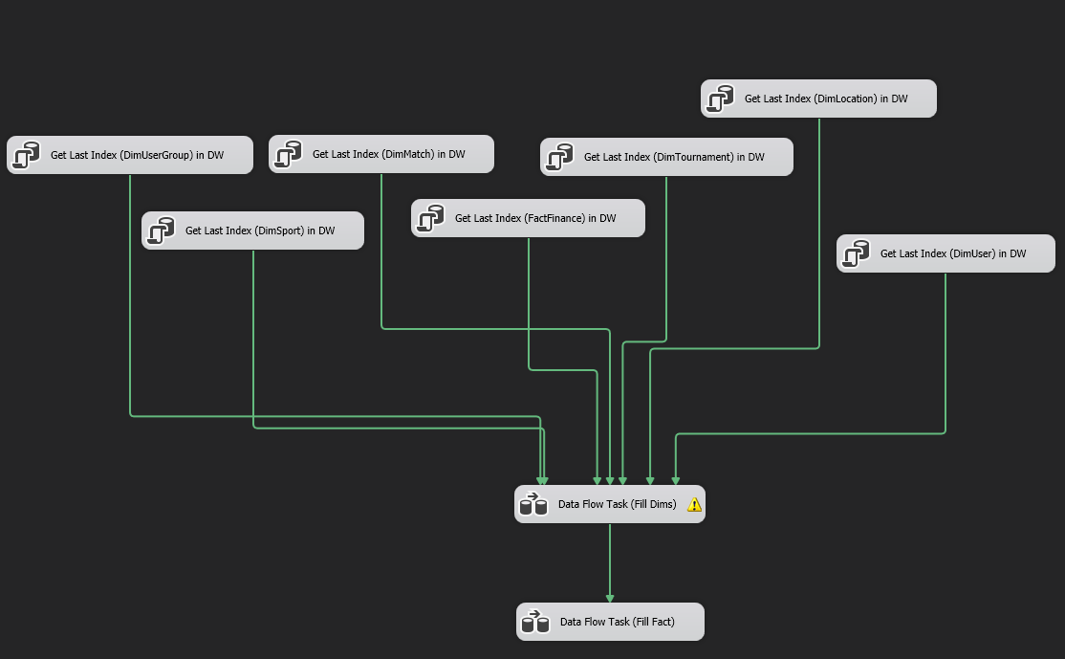
ETL – from OLTP to DW

Slide 15
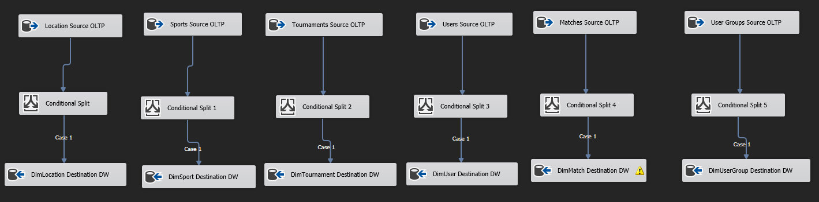
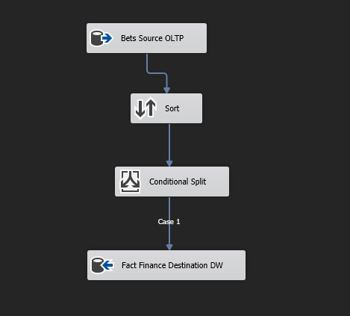
ETL – from OLTP to DW

Slide 16
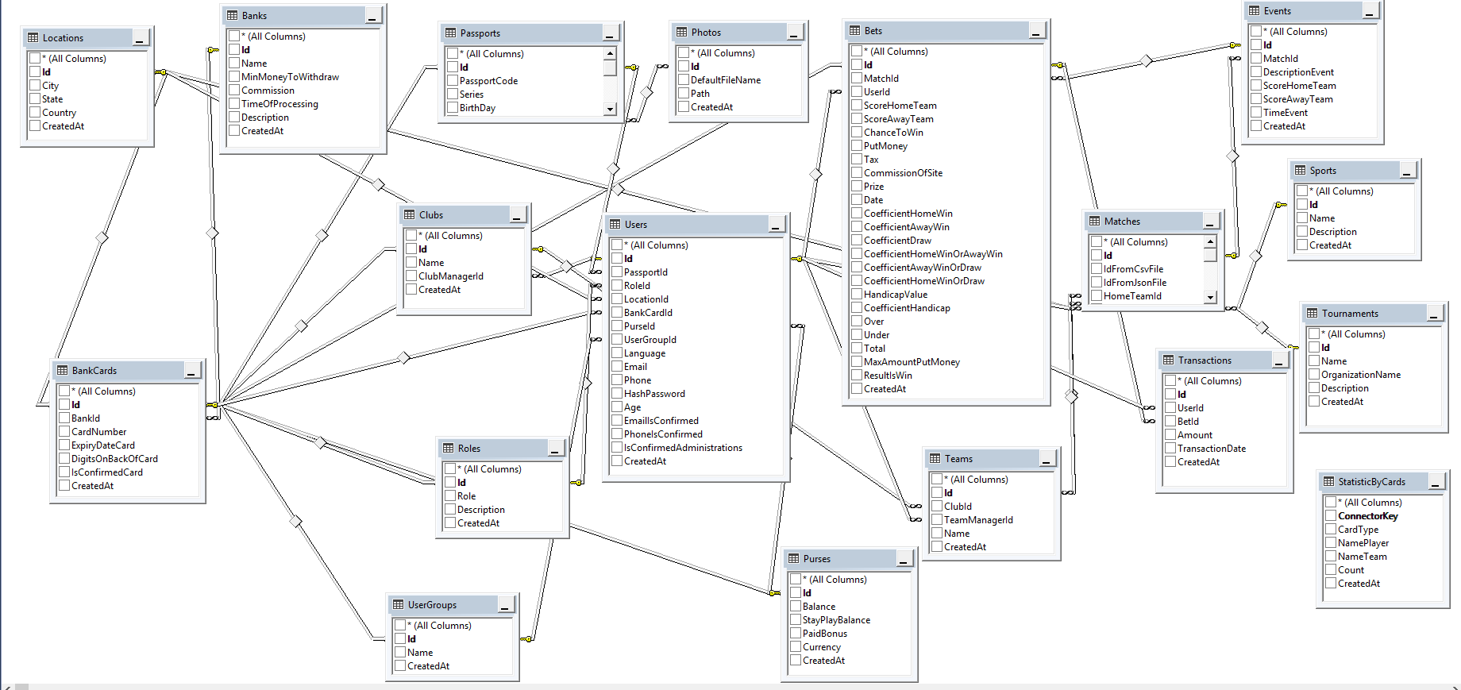
Schema OLTP Database

Slide 17
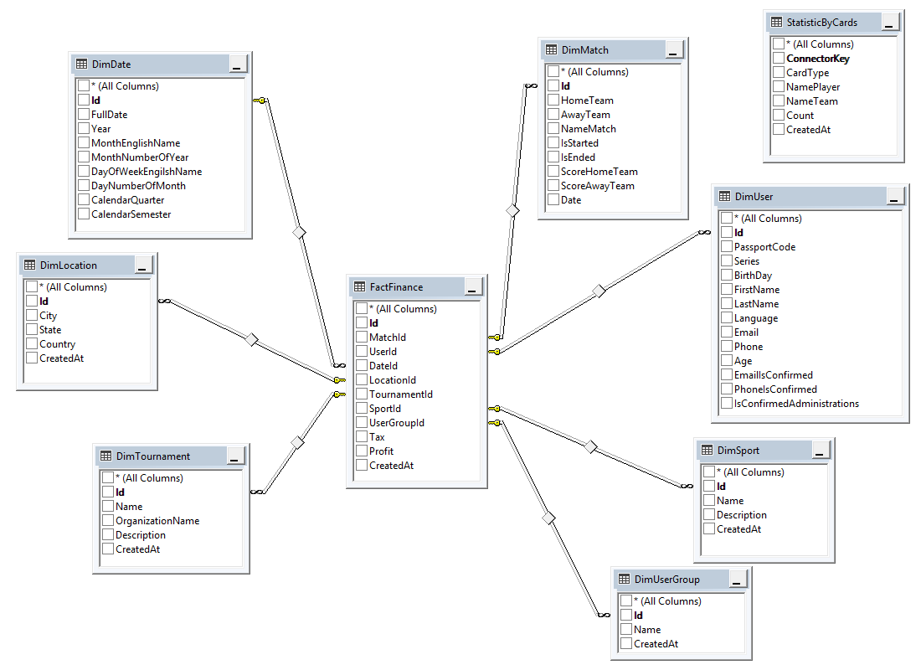
Schema DW Database

Slide 18
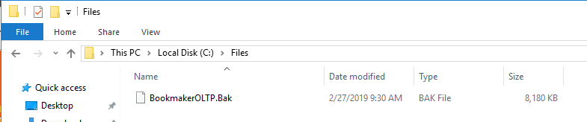
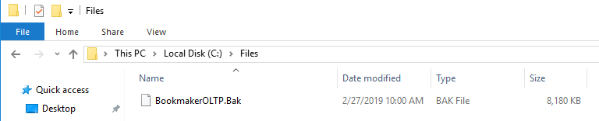
Backup database

Slide 19
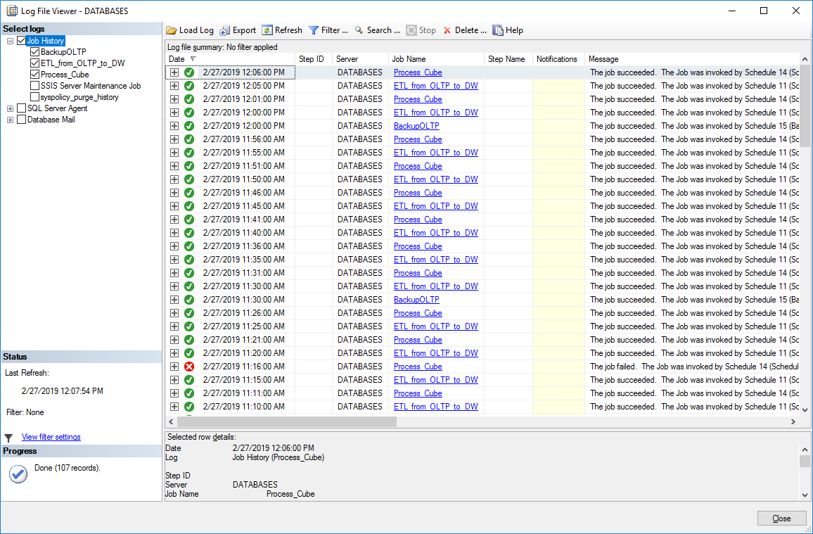
Schedule

Slide 20
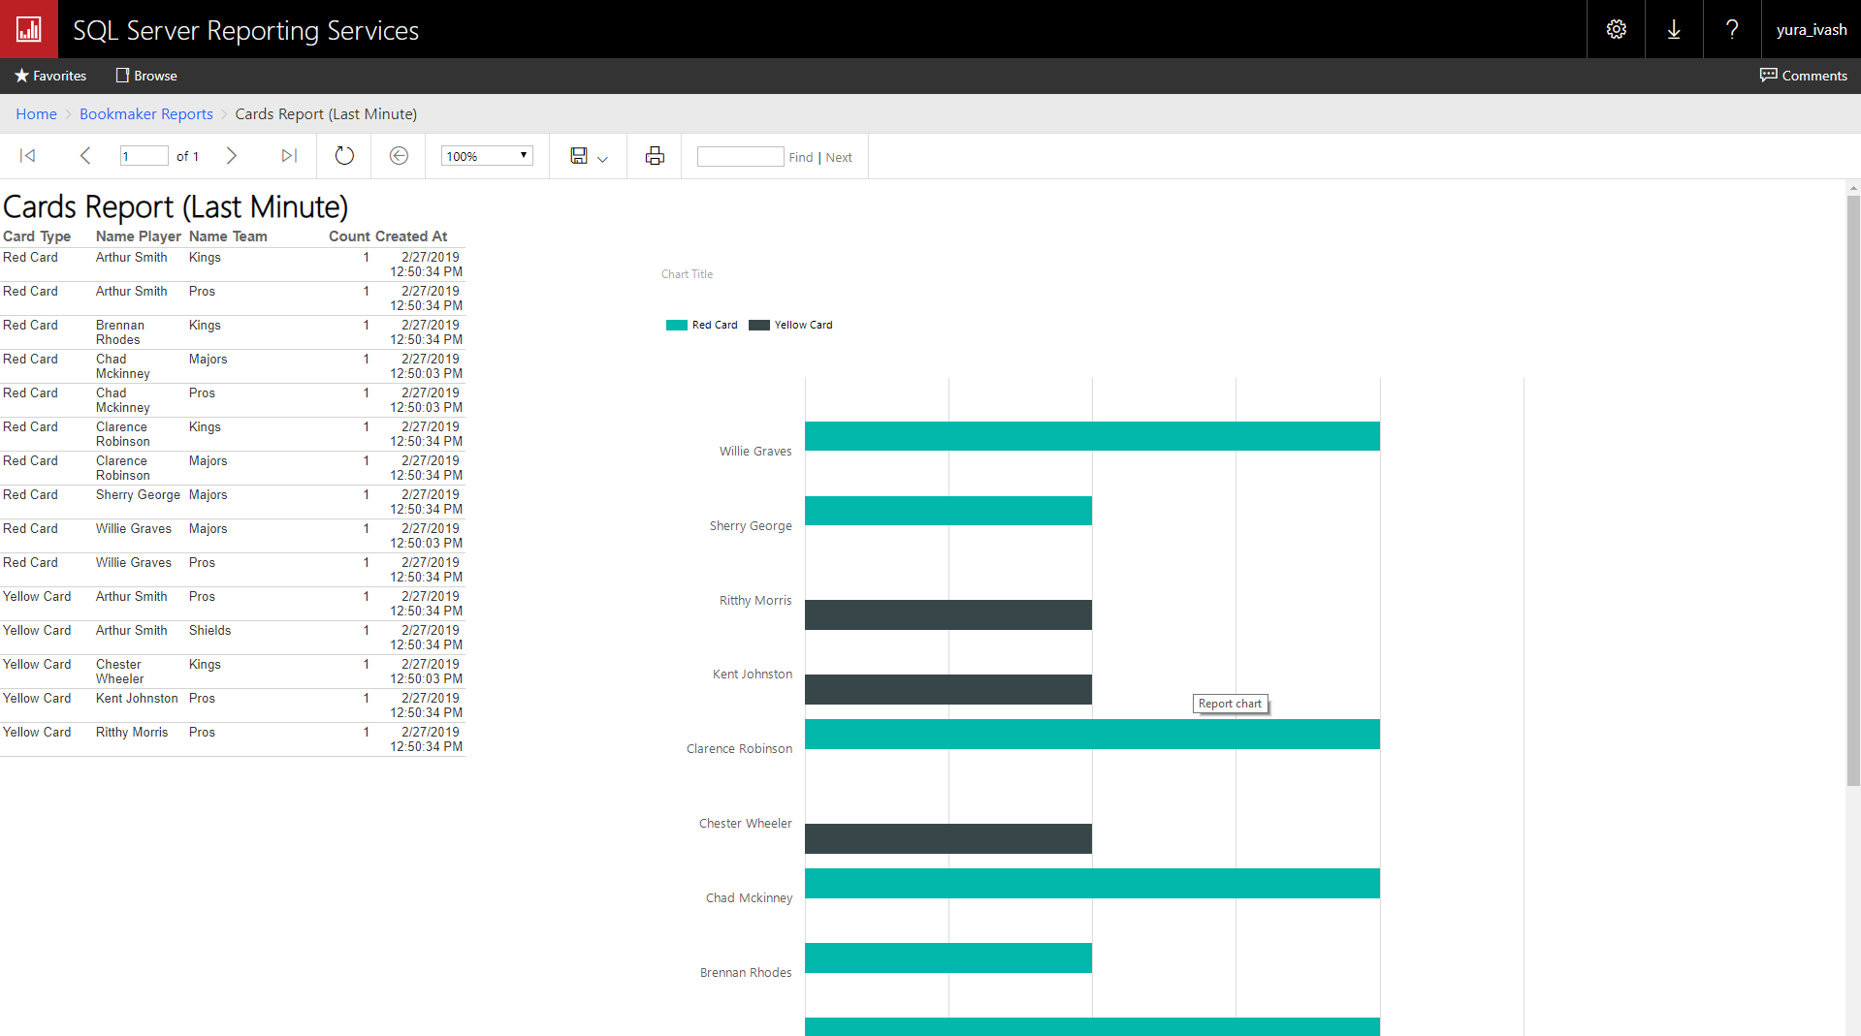
SSRS – Cards Report

Slide 21
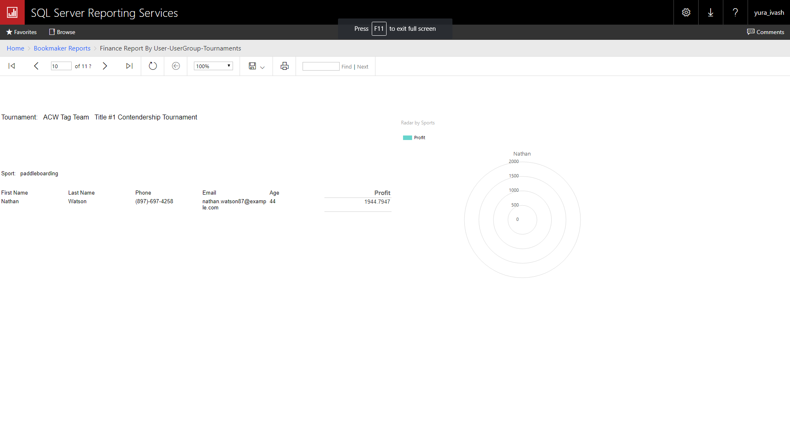
SSRS – report by User-User Group-Tournaments

Slide 22
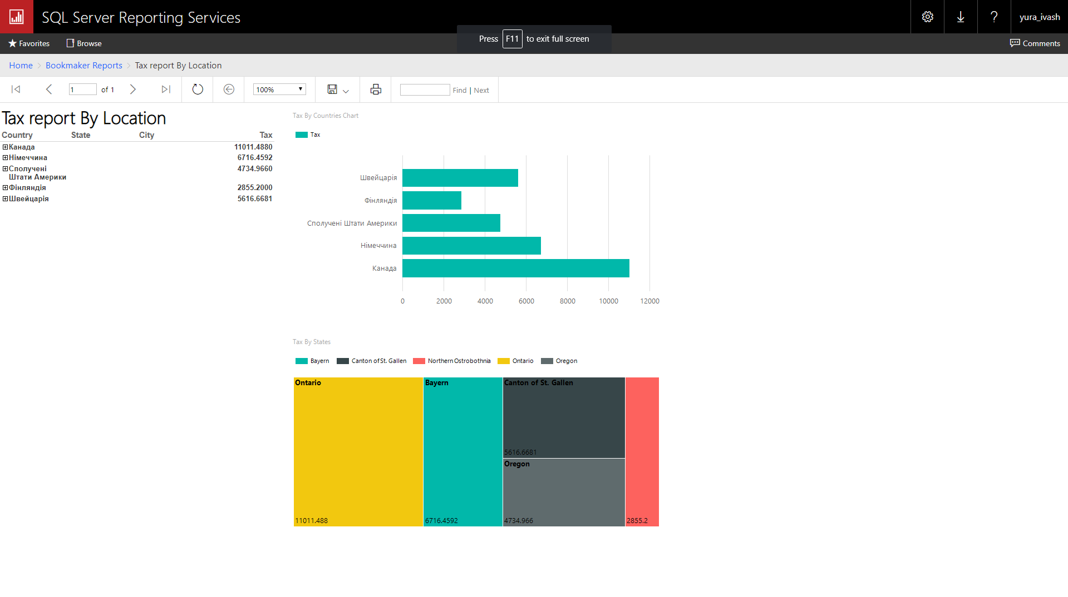
SSRS – Tax by location

Slide 23
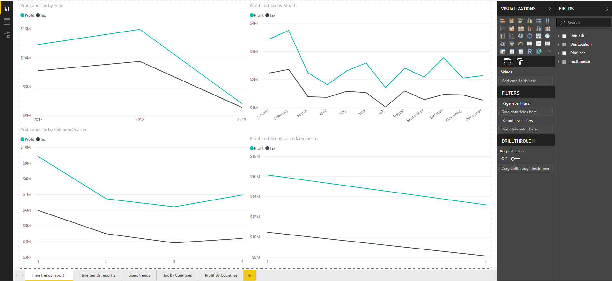
Power BI Desktop – Time trends

Slide 24
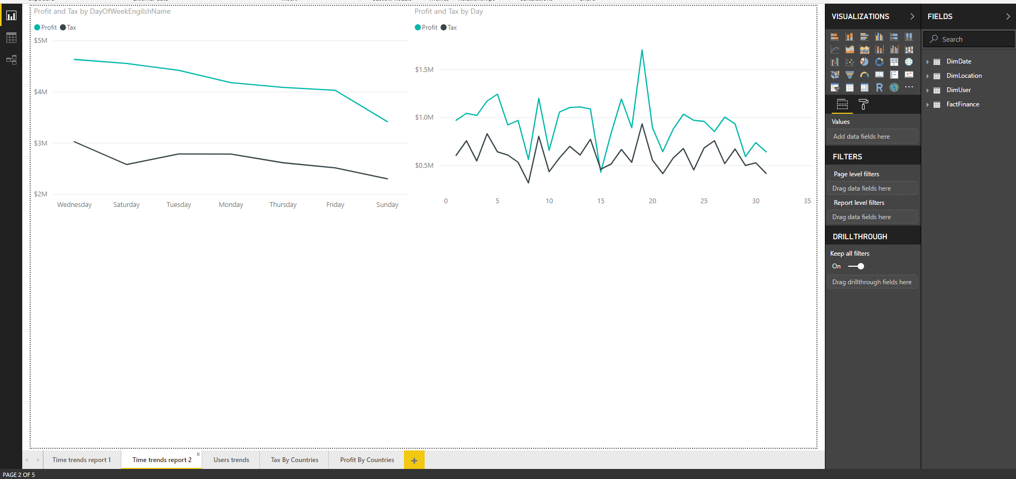
Power BI Desktop – Time trends

Slide 25
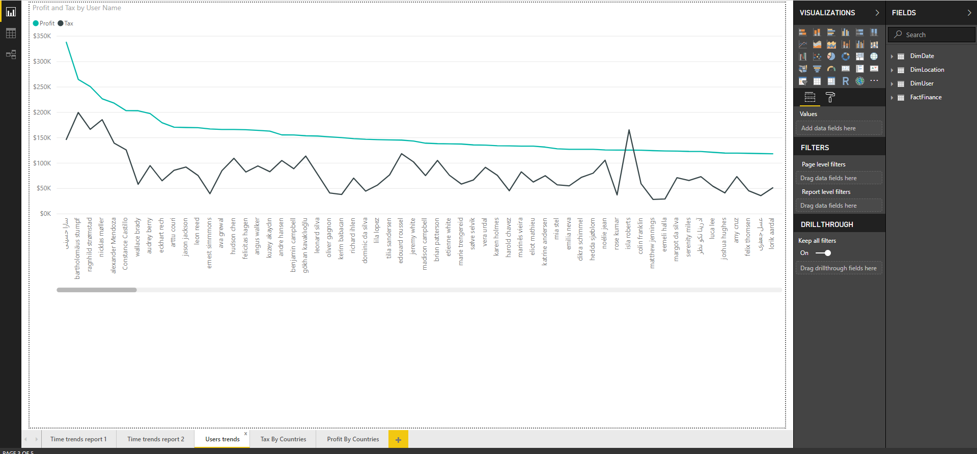
Power BI Desktop – User trends

Slide 26
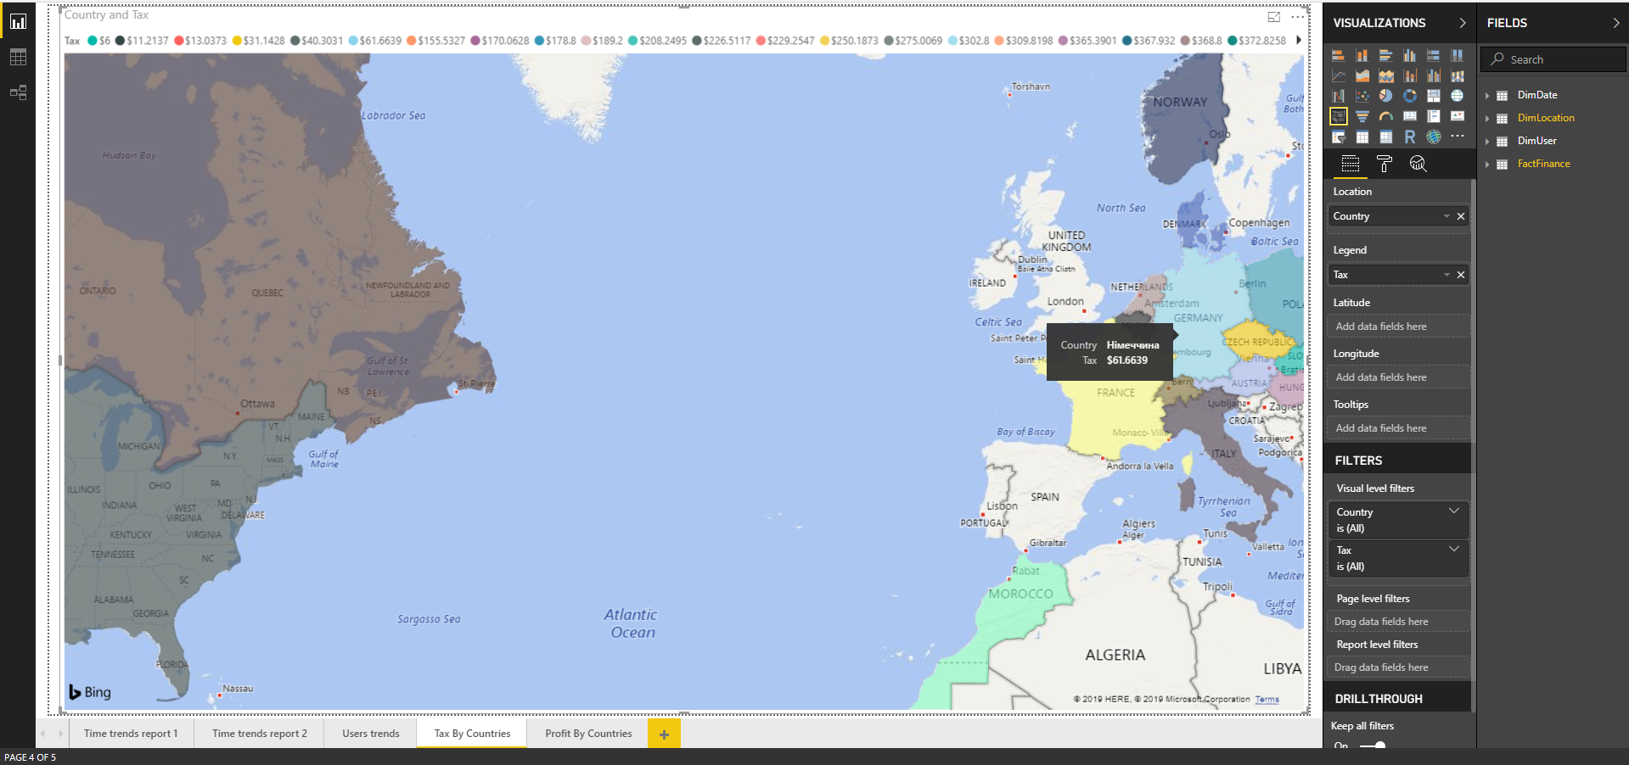
Power BI Desktop – Tax by location

Slide 27
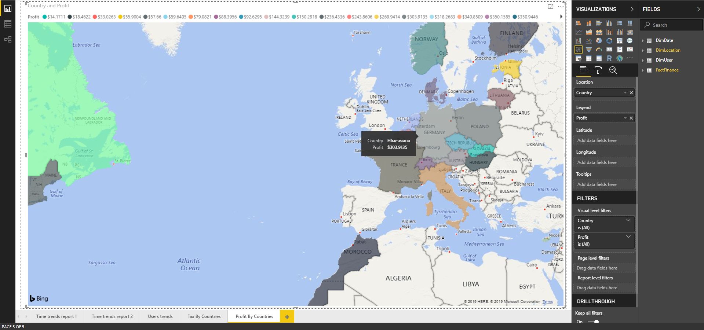
Power BI Desktop – Profit by location

Slide 28

Where hosted?

Slide 29
Demo

Slide 30
Q/A

Slide 31
Thanks for your attention!

